Slide 1

Marcus Kittelson
Student 2024

Slide 2
Summer Students- Final Presentation
**Remove when framework complete
Length: 10 – 15 minutes (Max 20 minutes) each student
Format: NVA template, you can use this one. Structure the presentation as you wish, this is meant as a guide!
In your presentation, please cover the following:
Introduction: who you are, where you are from, where you go to school, what are you taking in school & what year you are going into.
Share about your projects during your time at NVA:
Description of the project
What were some challenges you faced? How did you overcome them?
What did you learn
How did your project impact or support the business?
What’s Next for you?
What are your future career goals? Did this summer change or affirm your goals?
Questions
- 5 minutes for questions

Slide 3
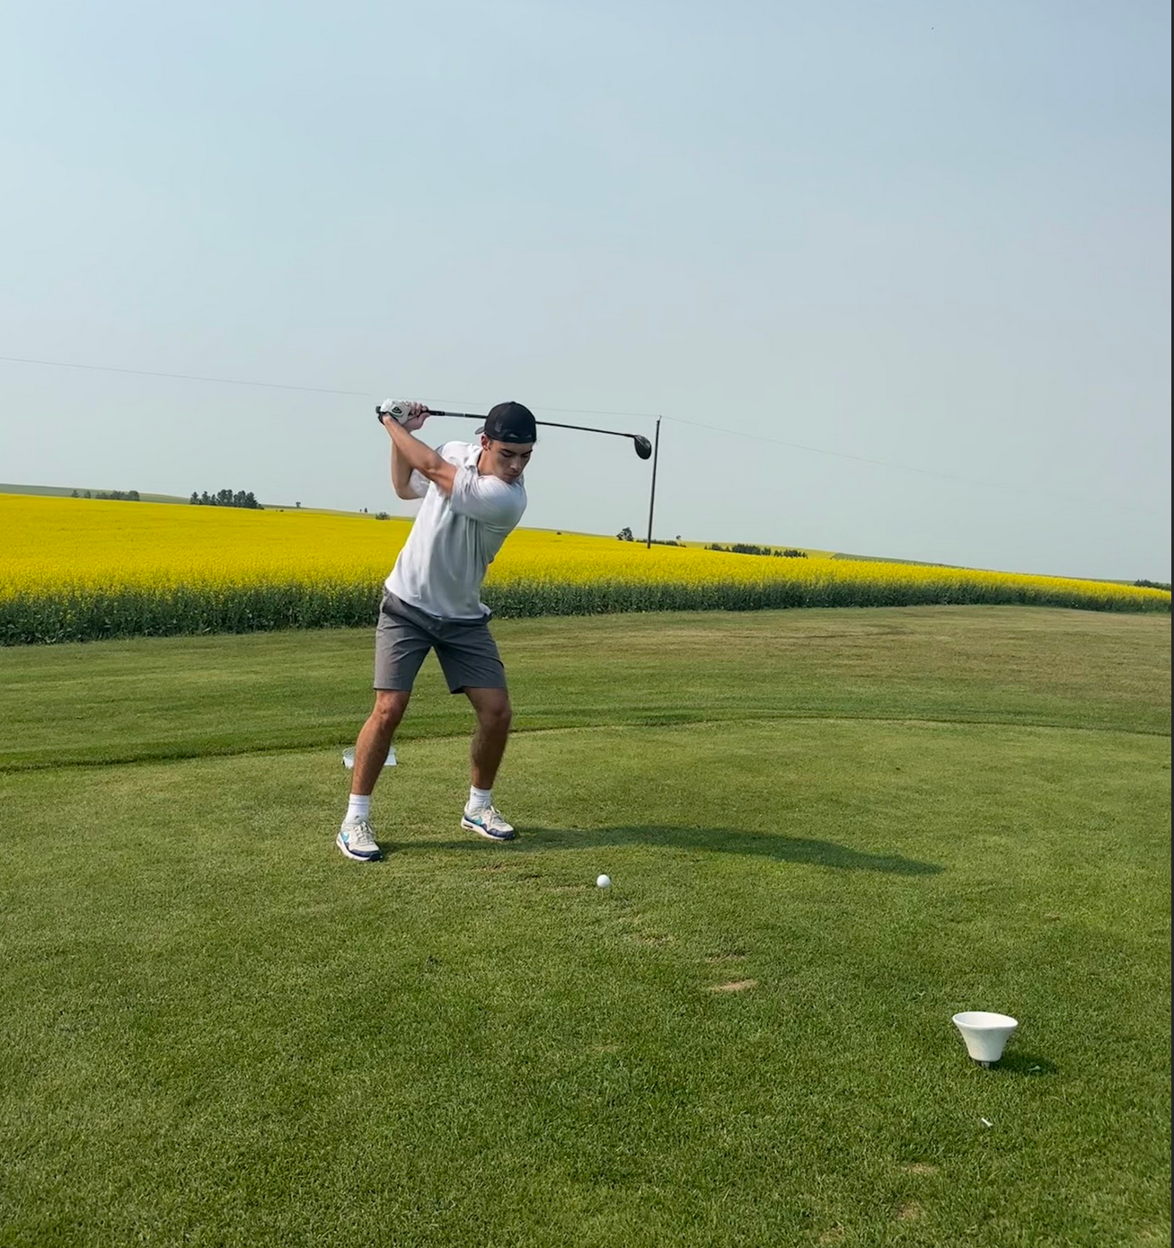
Introduction
Marcus Kittelson
16 Month Co-op Development Engineering Student
Education:
Software Engineering - University of Calgary (2021 - 2026)
Machine Learning Specialization - Stanford Online (July 2024)
Previous Work Experience:
Data Scientist Intern - M2M Tech (Summer 2023)
Safety Monitor - ‘The Last of Us’ HBO Series (2021 - 2022)
Interests:
Variety of Sports and Activities (Basketball, Hiking) *format nicer
**Decide either no personal photos or do a few

Slide 4
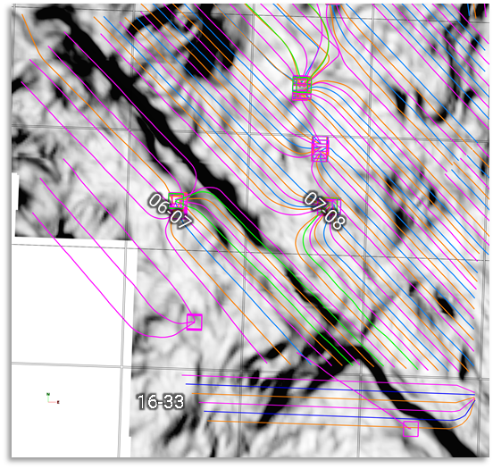
Project Description
*decide if want to be more concise and shorten word count
Problem Statement:
Q1 2024 Pipestone North Pad (06-07-072-09W6) experienced high levels of well to well fracture interaction and subsequent sand placement issues, as well as observations of casing ovality during coil mill out operation
Issues driven by natural fractures / faulting features identified in area
Q2 2024 Pipestone North Pad (16-33-071-09W6) to be developed across same features identified at 06-07-072-09W6
Project Goals:
Further automation of all completion, pressure and seismic (surface array tool) data
Introduction of Realtime Analytics Dashboard allowing team to analyze real time data and make informed operational decisions to improve sand placement, pumping time as well as mitigate casing ovality concerns
Project Outcome
Analytics Dashboard allowed team to better monitor sand placement and pressure trends leading to xx% improvement in sand placement and xx% improvement in pumping time
Q2 2024 Pad (16-33) subsequently completed at 675$/tonne vs Q1 2024 Pad (06-07) at 785$/tonne
06-07P2 (Q1 2024)
Identified Feature
*discuss improvement numbers with Brian
16-33 (Q2 2024)

Slide 5
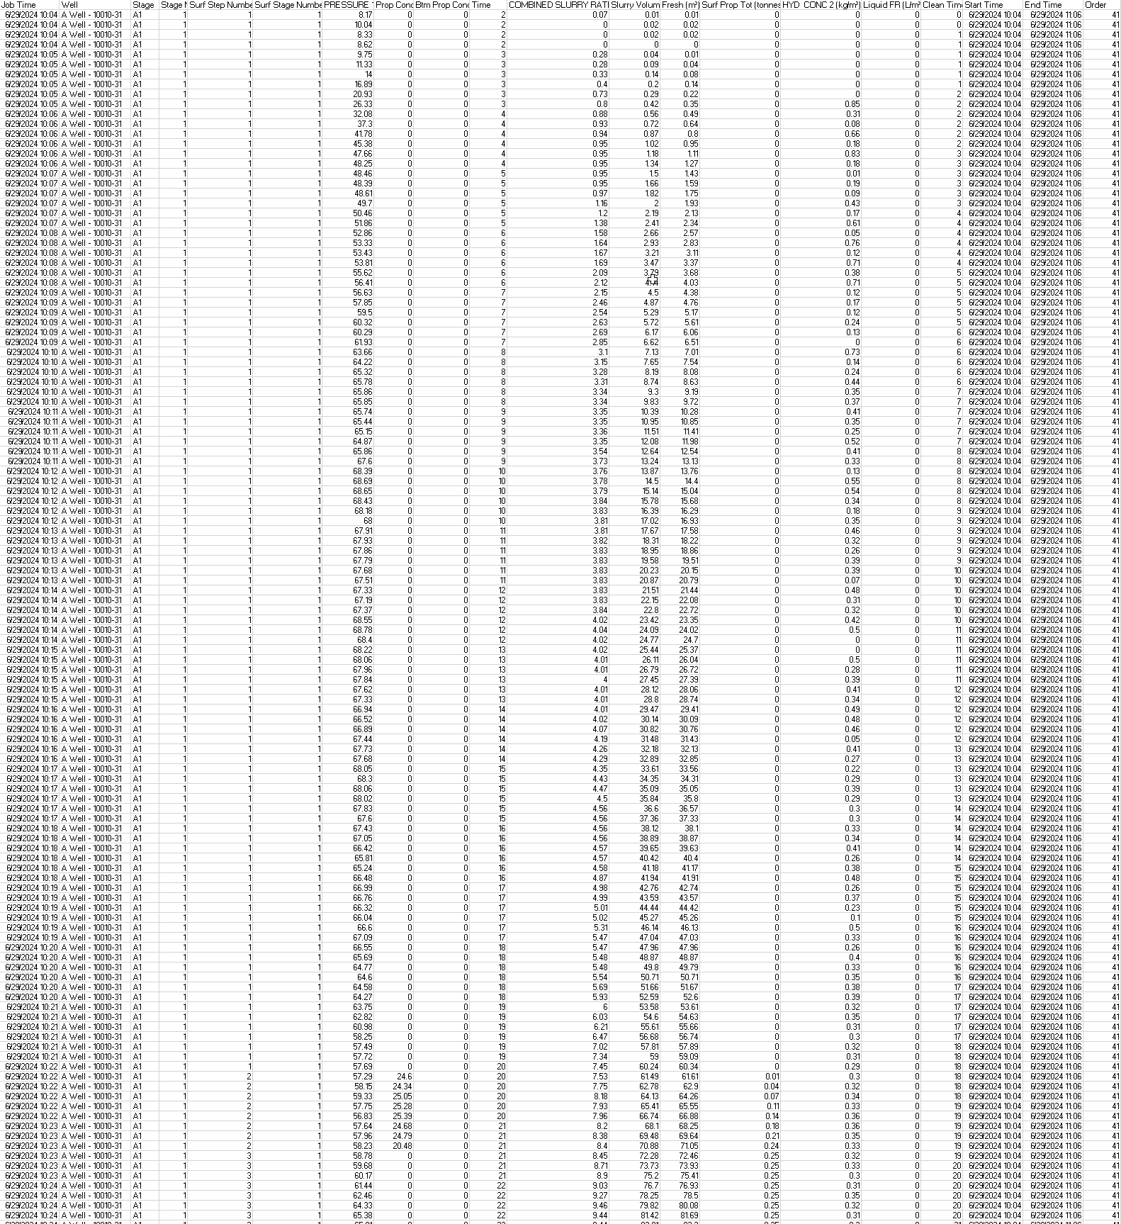
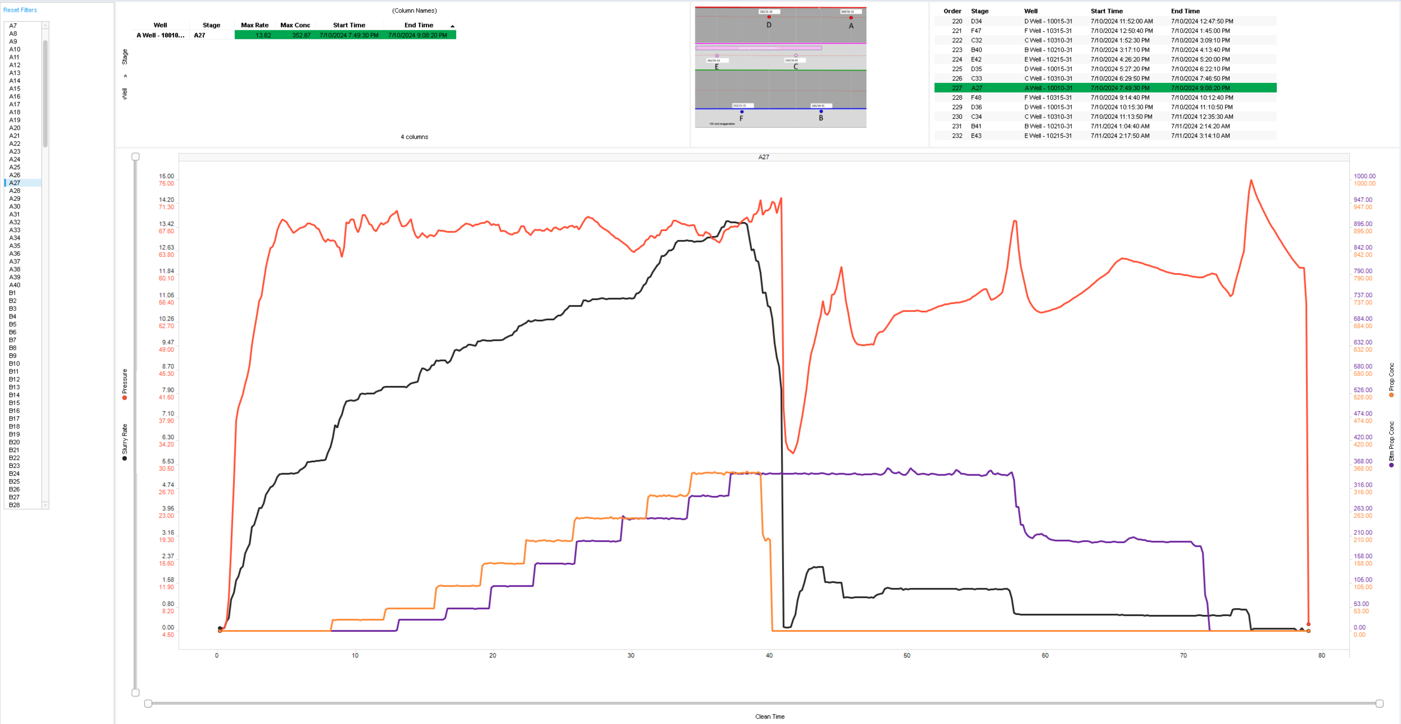
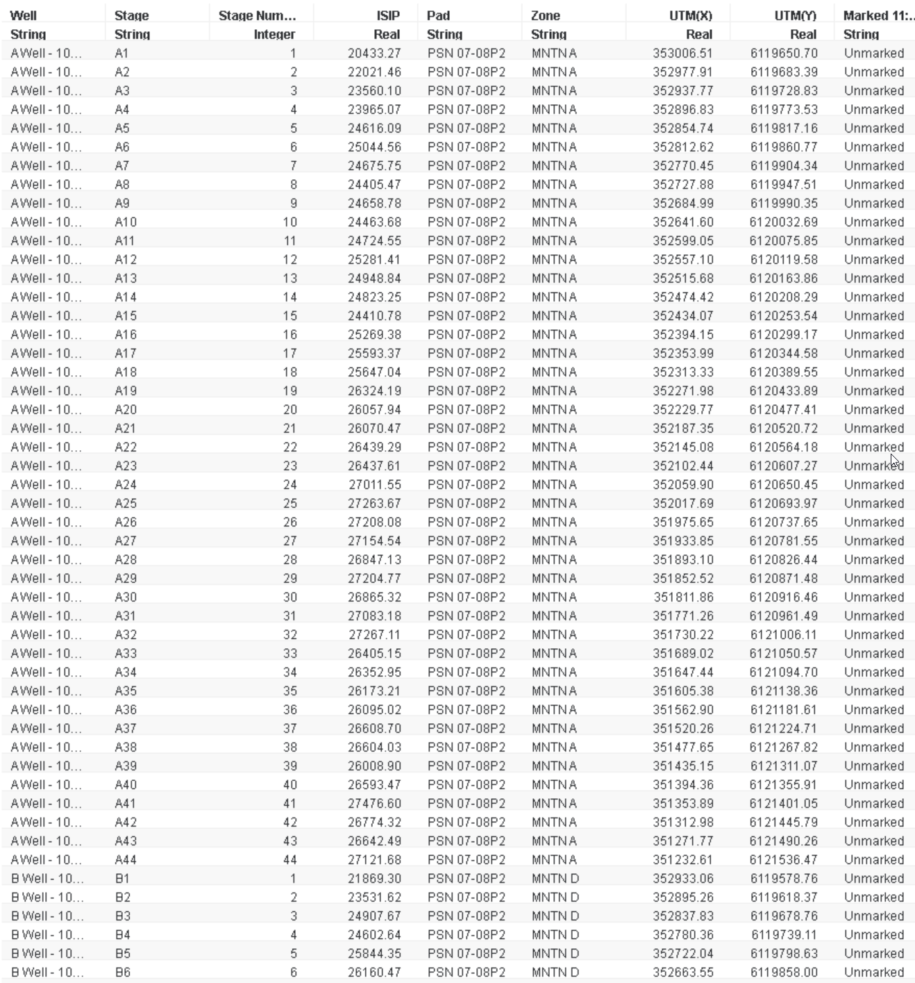
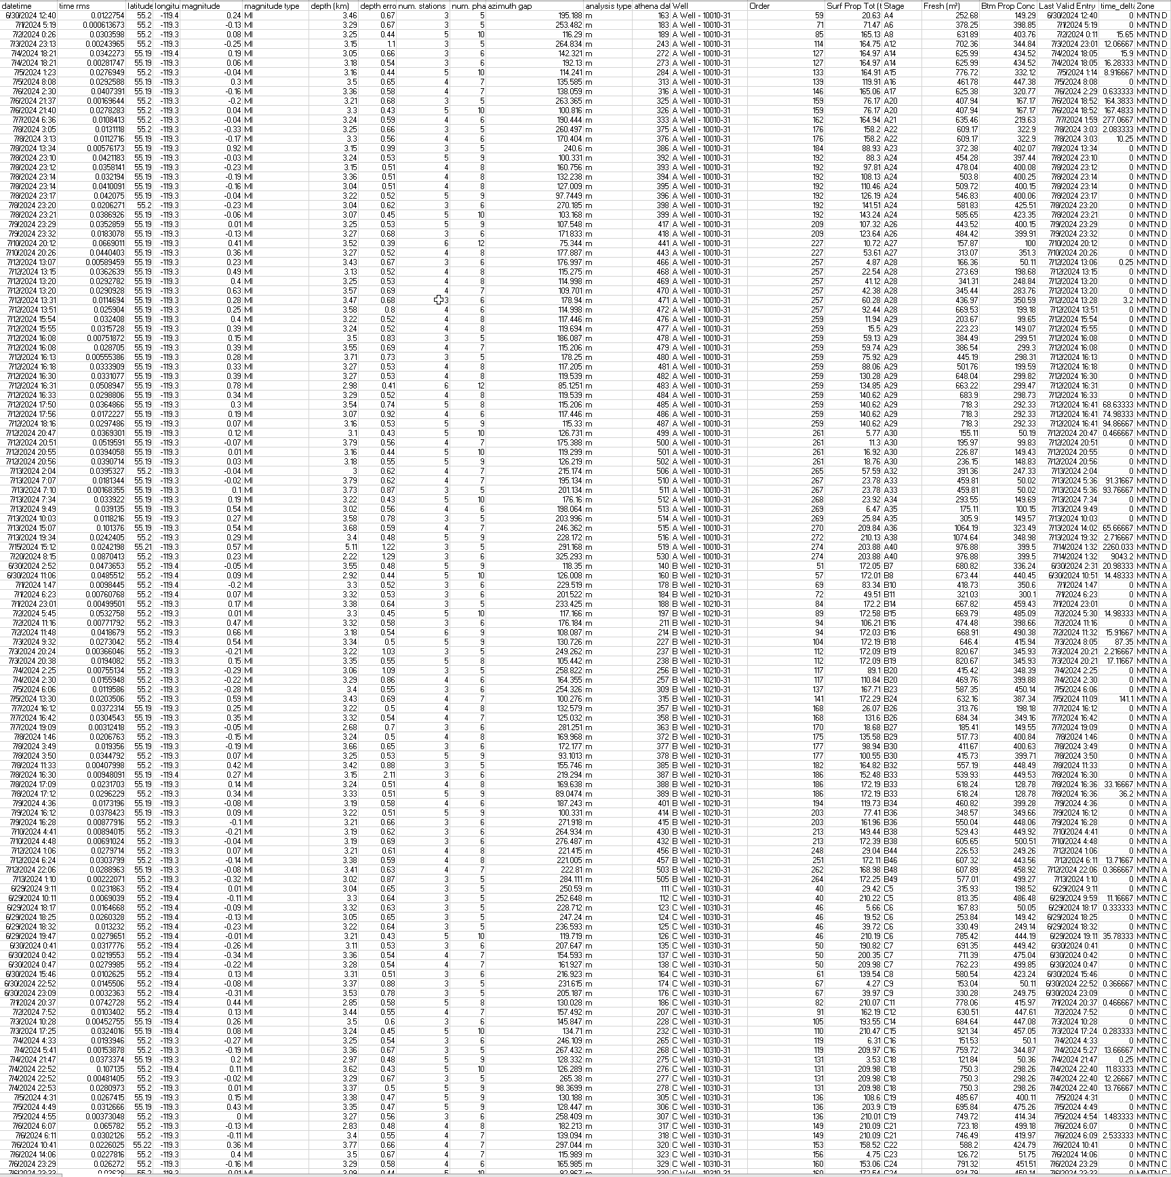
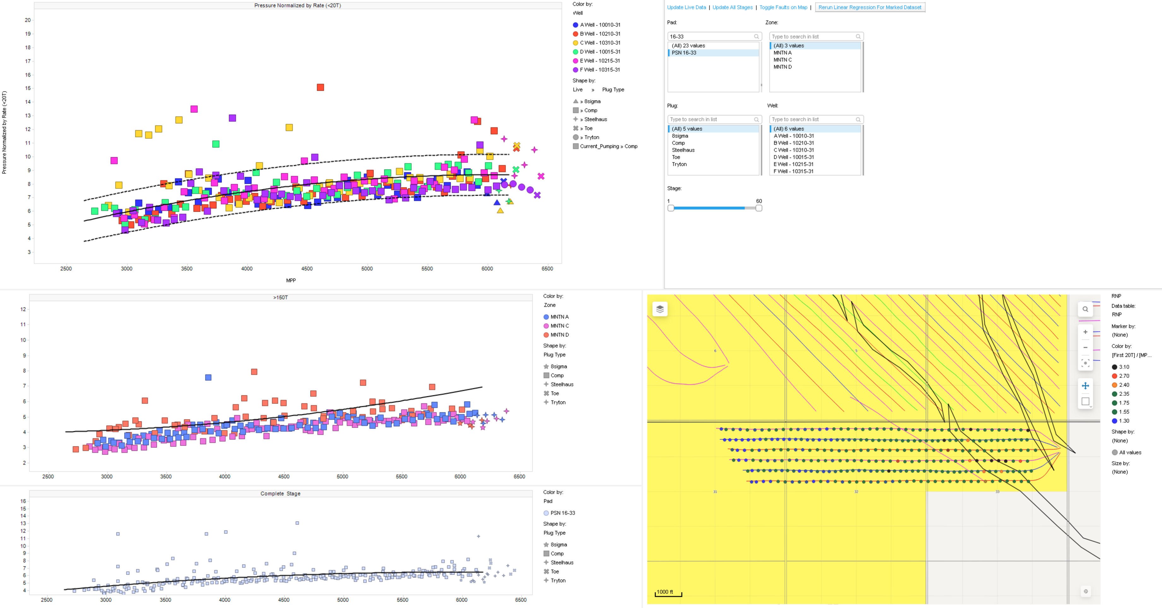
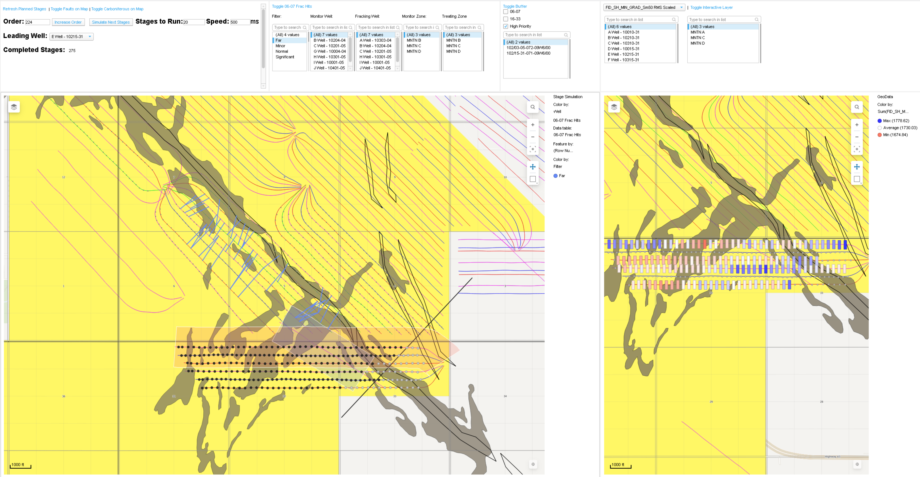
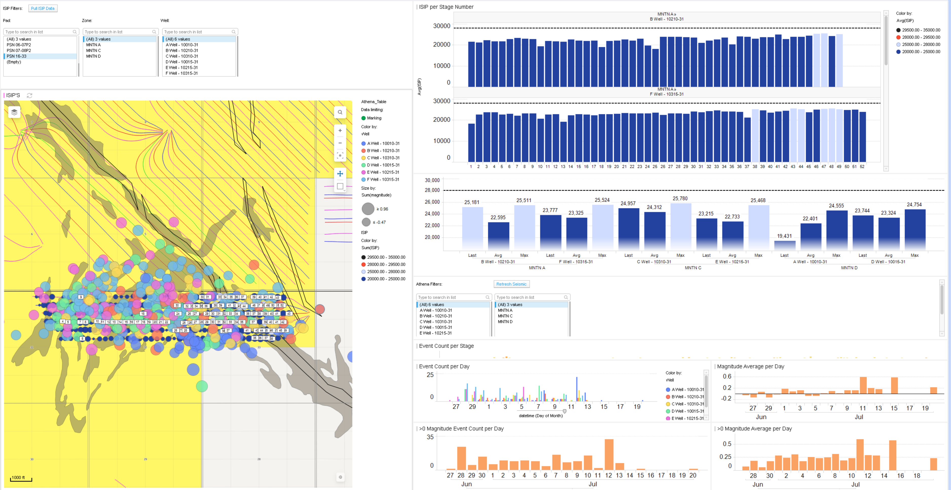
16-33 Spotfire Dashboard
*Go to an even higher level? Explain what Spotfire is? Data visualization tool.
Project Overview
Converting large amounts of data into interpretable insights for live decision-making
Raw Data (500,000+ Datapoints)
Realtime Spotfire Visualizations

Slide 6
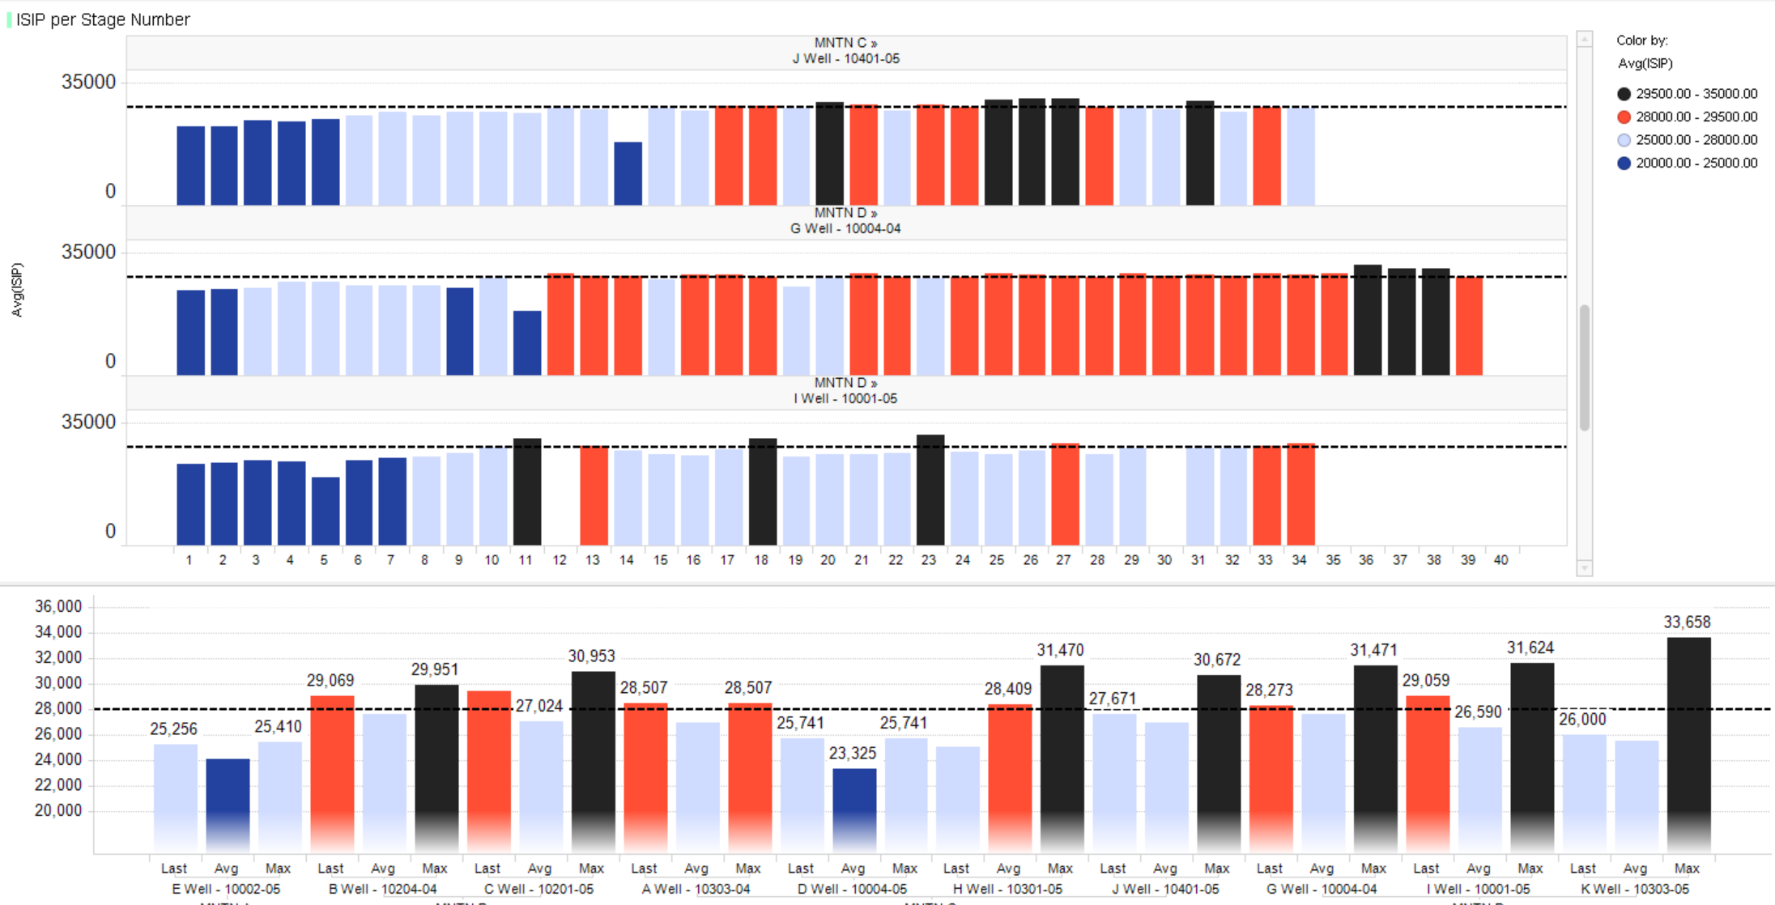
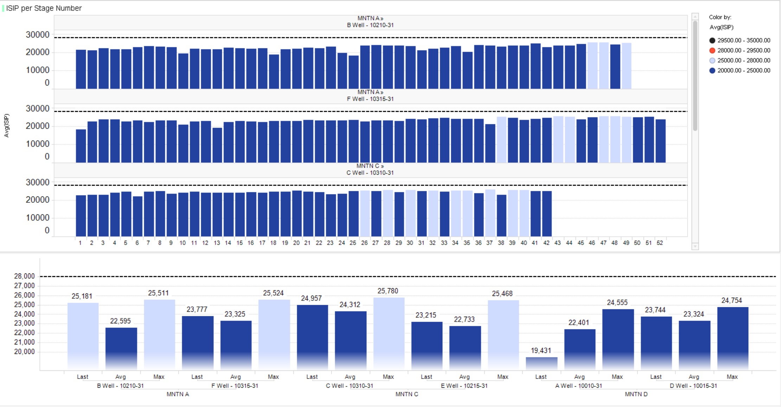
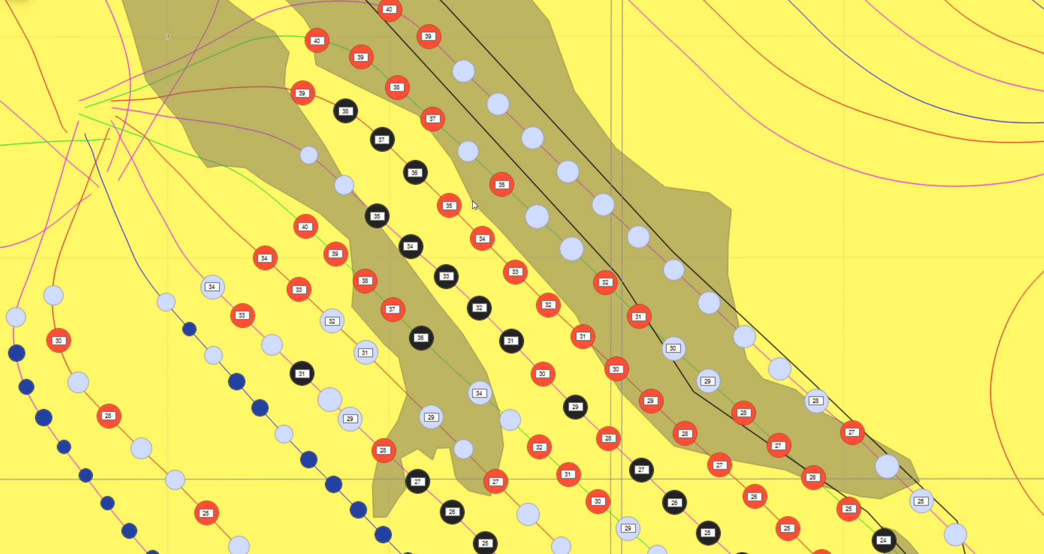
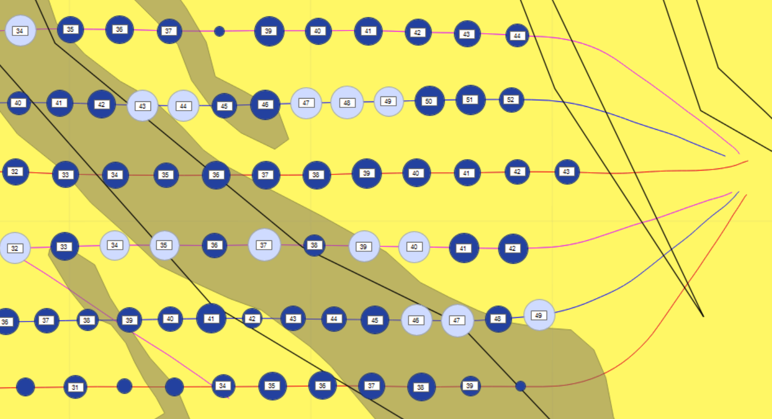
Initial Shut-In Pressure (ISIP)
*Use “Initial” or “Instantaneous”
16-33 Spotfire Dashboard
*Should clarify and start with ISIP definition
Spotfire dashboard automatically extracts ISIP values from gauge data and plots them, enabling quick identification of pressure trends.
06-07 (Q1 2024)
16-33 (Q2 2024)
Pressure Categories
29500 – 35000: {Bad – {Risk}}
28000 – 29500: {High – {l risk}}
25000 – 28000: {Ideal}
20000 – 25000: {Fine}
*Add Importance of ISIP / A direct value add -> touch up what each colour really means

Slide 7
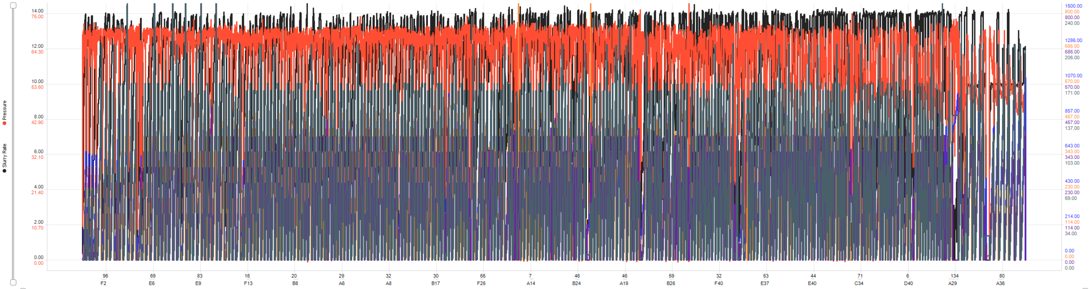
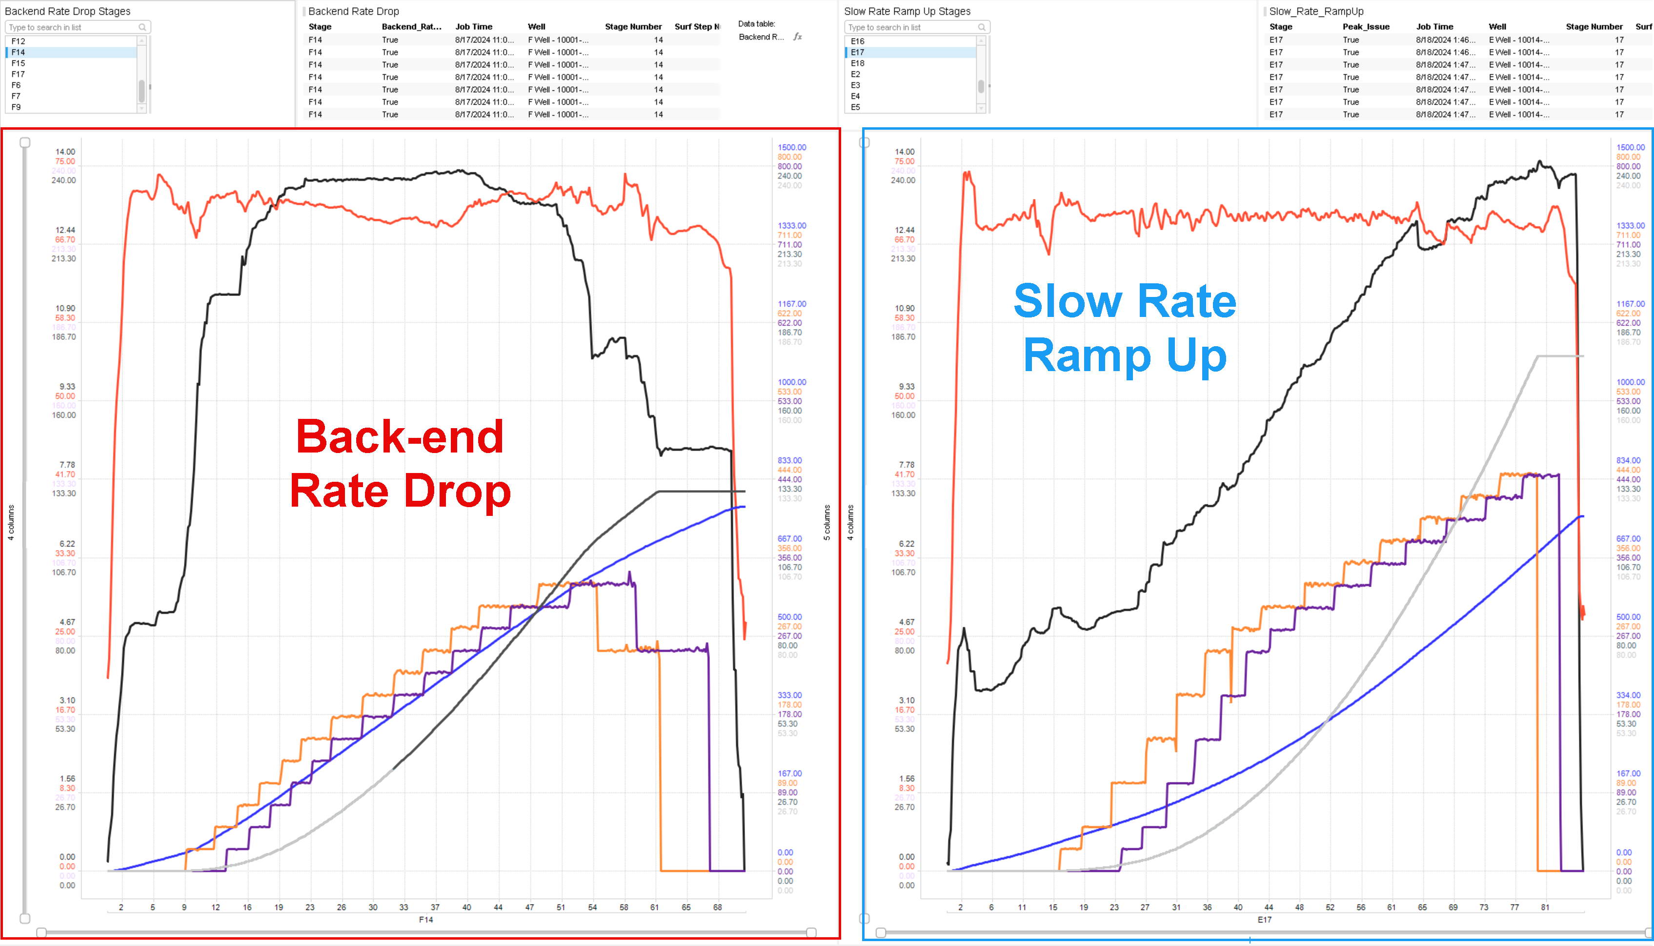
Frac Metric Automation
Pumping Data (Over 120,000 Datapoints)
16-33 Spotfire Dashboard
Backend Rate Drop Algorithm
Searches through pumping data and flags significant
and sustained rate decline in stages
Reduces redundant manual data skimming, with
instant identification of challenging stages
Slow Rate Ramp-Up Algorithm
Detects stages that were slow to reach maximum slurry rates,
*- explain offers additional insight
Pressure Decline Rate Script
Identifies pressure decline periods after stage was fracked
and calculates the pressure decline rate (-kPa/min)
* what do these values tell us? *talk w/ Katie
Input
Python Code:
Rate Drop Detection Algorithm
Output

Slide 8
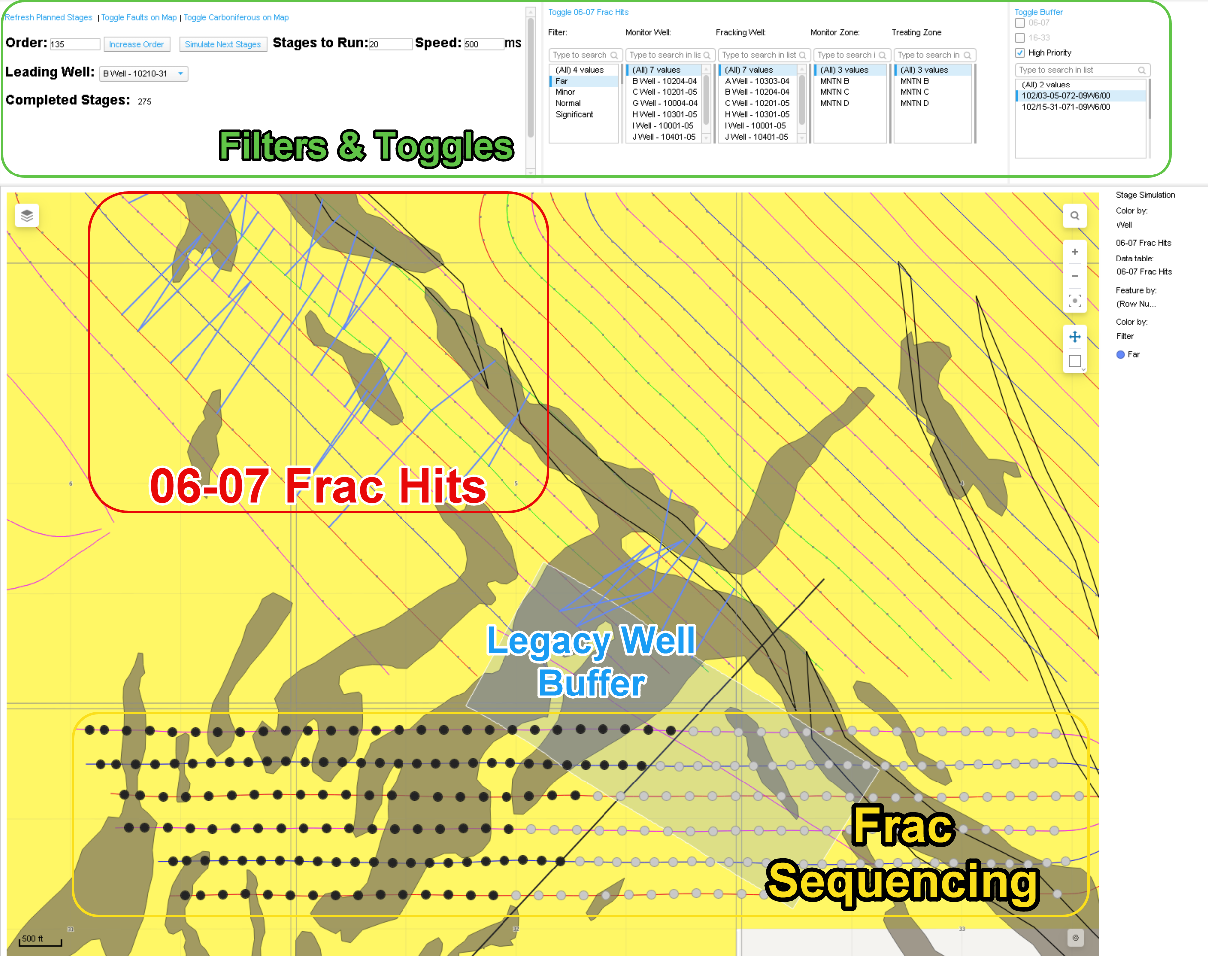
Frac Planning
16-33 Spotfire Dashboard
Dashboard contains geological data, 06-07 frac hits to show communication paths, well proximity buffers, and frac sequencing visualization *mention importance of this pages content, rework
*Add a comparison to prior planning workflow – talk w/ Brian}

Slide 9
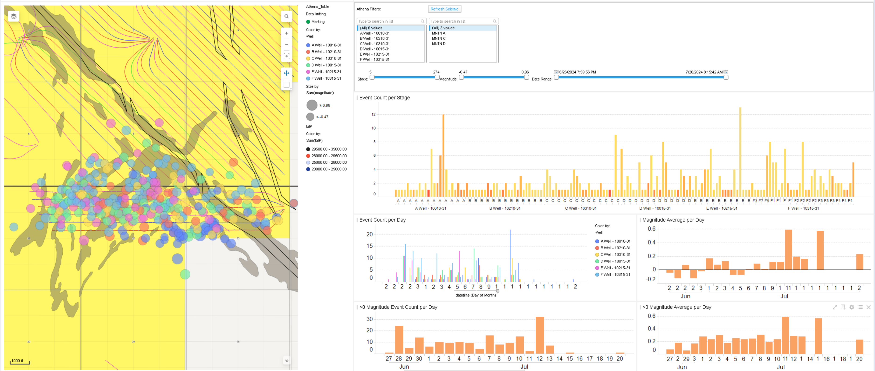
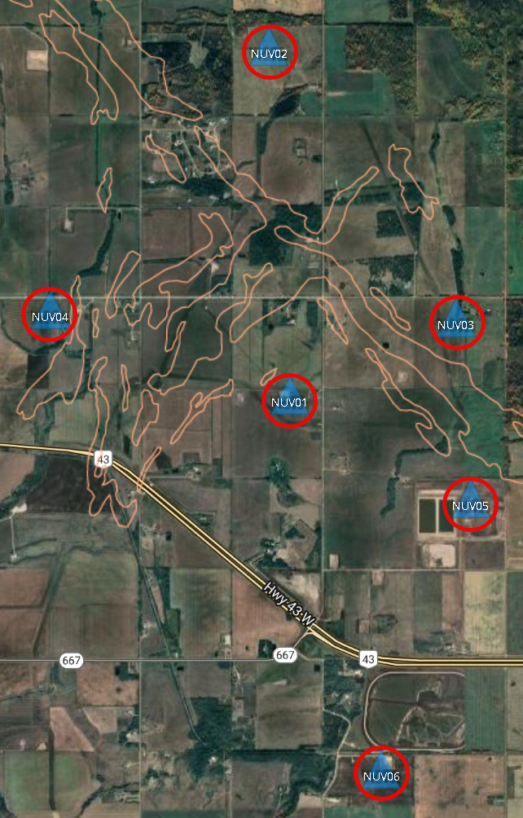

Seismic Array Data
16-33 Spotfire Dashboard
Integrated Python-driven seismic monitoring to identify seismic risks, {*include point on proactive benefits in the case high magnitude was present – talk to MW}, and deepen understanding of fracture propagation.
Python Code:
Connects to seismic database & classifies events
Live Spotfire Visualization Output
Seismic Array

Slide 10
Machine Learning to Cluster Seismic Events (DBSCAN)
16-33 Spotfire Dashboard – Machine Learning
Machine learning algorithm clusters data by grouping points based on their density, without need
Clusters events based on the location and time they occur, can be changed to give more weight to different variables
Slide recomplete after talk w/ Matt White -> ensure high level and clear

